Slide 1


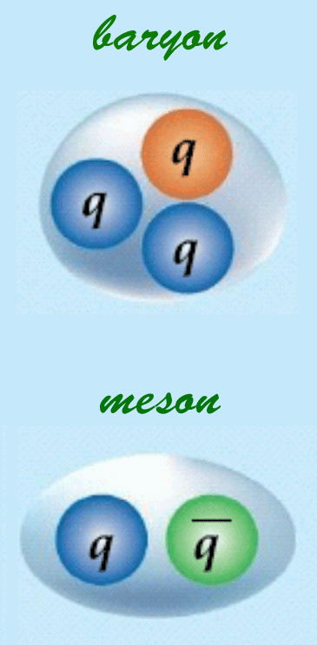
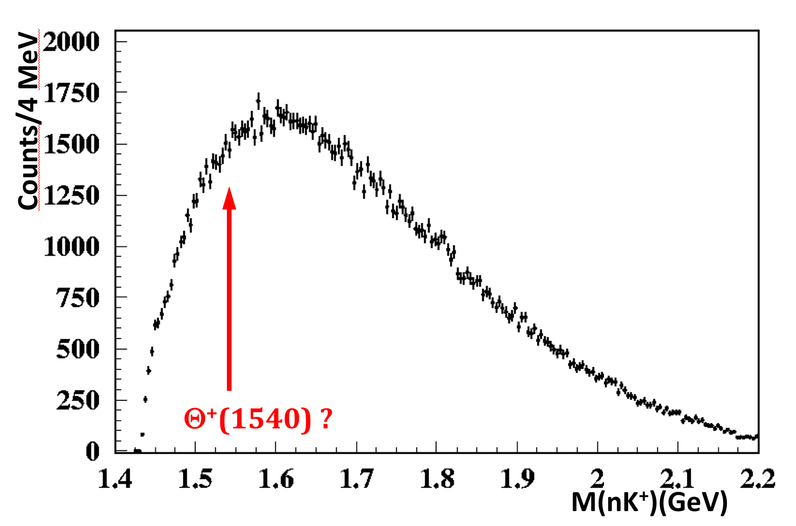
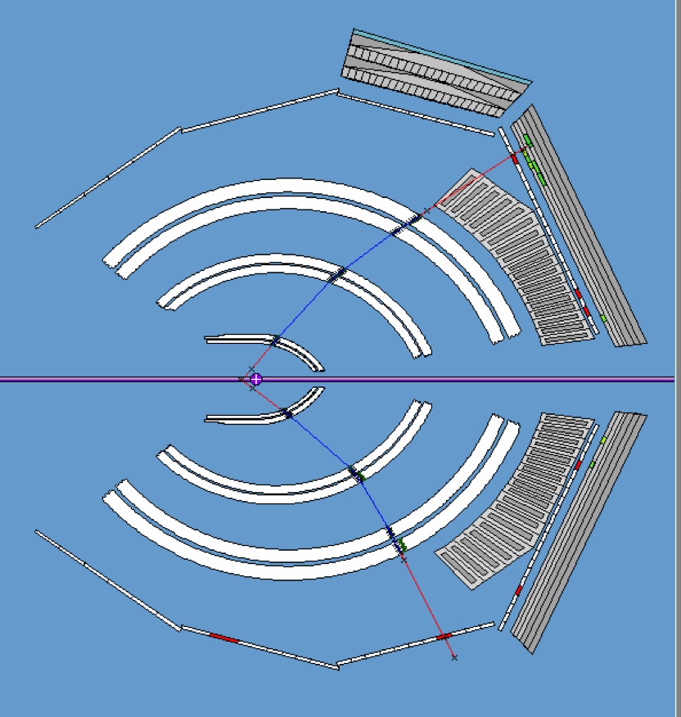
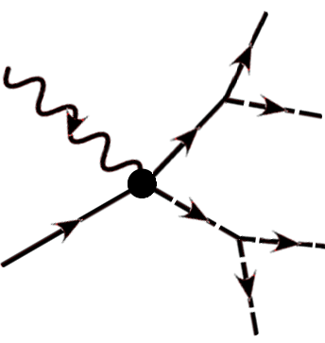
Hall-B Targets
Thomas Jefferson National Accelerator Facility
G11: looking for Pentaquarks
Quarks are among the few known elementary particles
Quarks interact by the strong force through the exchange of gluons forming hadrons, the building blocks of ordinary matter.
So far we have only observed two configurations:
Baryons, formed by 3 quarks. For example, protons, neutrons
Mesons, formed by a quark-antiquark pair. For example pions, kaons.
However Quantum Chromo Dynamics allows hadronic states with different quark configurations (4q, 5q, 3qg). Do these exist? G11 looked for a 5q configuration: the pentaquark.
G11 searched for pentaquarks shooting a very high intensity photon beam on a proton target, designed specifically for the experiment.
Theoretical physics indicates that the pentaquark, if it exists, may have a certain mass and may decay a certain way. In g11 we looked for the allowed photo-production of a pentaquark that decays into the known particles kaons and neutrons.
Results
The arrow shows where the pentaquark signal should have been, in the form of a “bump”. Can you see it? Neither could we.
G11 found no indication of a narrow resonance.
Does it mean that the pentaquark does not exist? Not exactly. It means that if it exists, the process is much rarer than we thought. The G11 experiment quantified an upper limit on how rare the pentaquark is.
Left: baryons and mesons, formed by 3 and 2 quarks, are what we know to exist in nature. Right: artistic representation of a pentaquark, looked for in the G11 experiment.
Two Photon Exchange (TPE): a beam of matter and antimatter
Beams of electrons have been a primary experimental tool in the study of hadron physics for many decades. The electrons interact with other particles by exchanging photons.
The process of exchanging one photon is more than 100 times more likely to happen than exchanging more than one photon. The effect of multiple photons exchange seems very small. However:
The proton size and charge distributions, aka form factors, have been measured many times with increasing precision over the but there’s a mystery: two measurement techniques give consistently very different results.
Physicists suspect that a two photon exchange mechanism is the cause of this unknown phenomenon.
With the TPE experiment we looked for studied these very small effects and look for answers to this mystery.
electron
electron
In order to measure such a small (by more than 100 times) effect and look for the Two Photon Exchange signature, Hall-B physicists and collaborators came up with a design to produce the first ever simultaneous positron and electron beam: a beam made of matter and antimatter. After 7 years of detailed simulation this project became a reality. The moment we saw the matter anti-matter beam was rather emotional.
The TPE signature can be quantified by measuring both electron and positron scattering and looking for differences between the two.
photon
proton
proton
Top: the most common interaction between electrons and other particles: the exchange of a single photon. Bottom: some of the two-photon-exchange mechanisms. These processes are very rare but may manifest in observable effects
Left: the first ever successful simultaneous electron/positron beam producing events on the TPE target. Elastic cross sections from both particles have been measured with percent precision. Right: main result of the experiment: the data available is fitted to a model (red line) able to reconcile the differences in measuring the proton form factor using different techniques. We will need more data but we’re on the right track to solving the mystery.

